Slide 1
CIFAR-10 Image Classification using CNN & Transfer Learning
Ensemble
MobileNetV2
EfficientNetB0
ResNet50V2
CNN
89.34 %
86.17 %
86.14 %
79.30 %
72.47 %

Slide 2
Agenda
Data Loading, Preprocessing, and Visualization
Custom CNN
01
02
Train and Evaluate the Custom CNN
Transfer Learning
03
04
Comparison Plots & Best Model
Ensamble
05
06

Slide 3
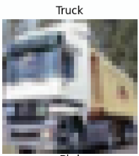
Data Loading and Visualization
Load Data
Get data from keras dataset.
Separate (X_train, y_train), (X_test, y_test)
Check class distribution
{'Airplane': np.int64(5000),
'Automobile': np.int64(5000),
'Bird': np.int64(5000),
'Cat': np.int64(5000),
'Deer': np.int64(5000),
'Dog': np.int64(5000),
'Frog': np.int64(5000),
'Horse': np.int64(5000),
'Ship': np.int64(5000),
'Truck': np.int64(5000)}
04
01
03
Class names for CIFAR-10
['Airplane', 'Automobile', 'Bird', 'Cat', 'Deer', 'Dog', 'Frog', 'Horse', 'Ship', 'Truck'].
Visualize sample images
02

Slide 4
Data Preprocessing
06
Normalize to [0, 1]
X_train = X_train.astype('float32') / 255.0
X_test = X_test.astype('float32') / 255.0
Data Augmentation Pipeline
data_augmentation = tf.keras.Sequential([
layers.RandomFlip("horizontal"),
layers.RandomRotation(0.1),
layers.RandomZoom(0.1),])
05

Slide 5
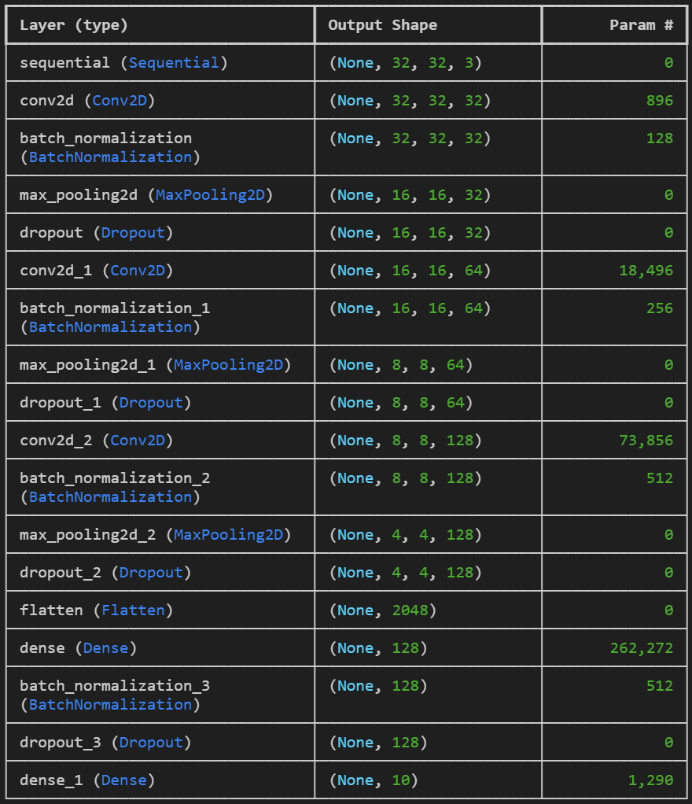
2. Building Custom CNN
Total params: 358,218 (1.37 MB)
Trainable params: 357,514 (1.36 MB)
Non-trainable params: 704 (2.75 KB)
Input Layer & Augmentation.
Models.Sequential
3 Layers Blocks:
-Conv2D(32/64/128, padding = ‘same’, activation = ‘relu’)
-BatchNormalization()
-MaxPooling2D((2, 2))
-Dropout(0.25)
Classifier Head on Layers:
Flatten()
Dense(128, activation='relu')
BatchNormalization()
Dropout(0.5)
Dense(10, activation='softmax')

Slide 6
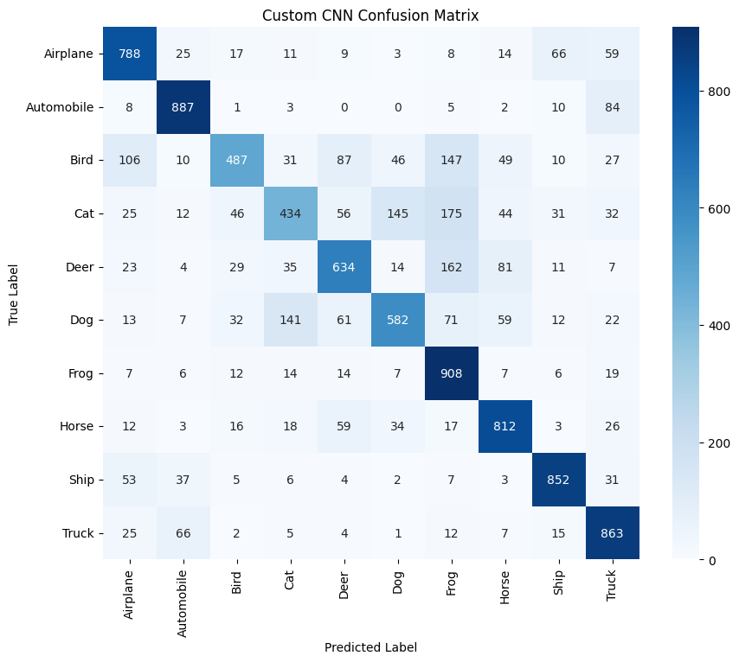
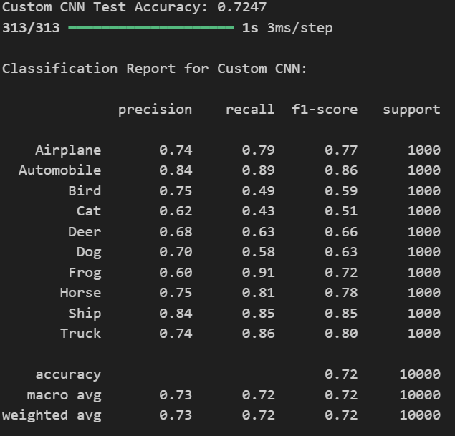
3. Train & Evaluate Custom CNN
custom_cnn.fit(X_train, y_train,epochs=30, validation_data=(X_test, y_test), batch_size=64, callbacks=[early_stopping, reduce_lr])
Confusion Matrix
optimizer='adam', loss='sparse_categorical_crossentropy', metrics=['accuracy'])
Compile the model
Train
Define Callbacks
Evaluate
EarlyStopping(monitor='val_loss', patience=5, restore_best_weights=True)
ReduceLROnPlateau(monitor='val_loss', factor=0.2, patience=3, min_lr=1e-6)
Dynamically reduces the learning rate when a monitored metric (validation loss) stops improving after a specified number of epochs (patience)

Slide 7
4. Transfer Learning (MobileNetV2, EfficientNetB0, ResNet50V2)
Run the three transfer learning models, compare them and get the best one.
MobileNetV2
EfficientNetB0
ResNet50V2
Full Pipeline
Expects [-1, 1]
layers.Lambda(
lambda x:
(x * 2.0) - 1.0)
Expects [0, 255].
layers.Rescaling
(255.0)
Has its own complex scaling utility
layers.Lambda(
lambda x: tf.keras.applications.resnet_v2.preprocess_input
(x * 255.0))
models.Sequential([ layers.Input(
shape=(32, 32, 3)), layers.Resizing(96, 96),
preprocess,
base, layers.GlobalAveragePooling2D(), layers.Dropout(0.3), layers.Dense(
10,activation='softmax’)

Slide 8
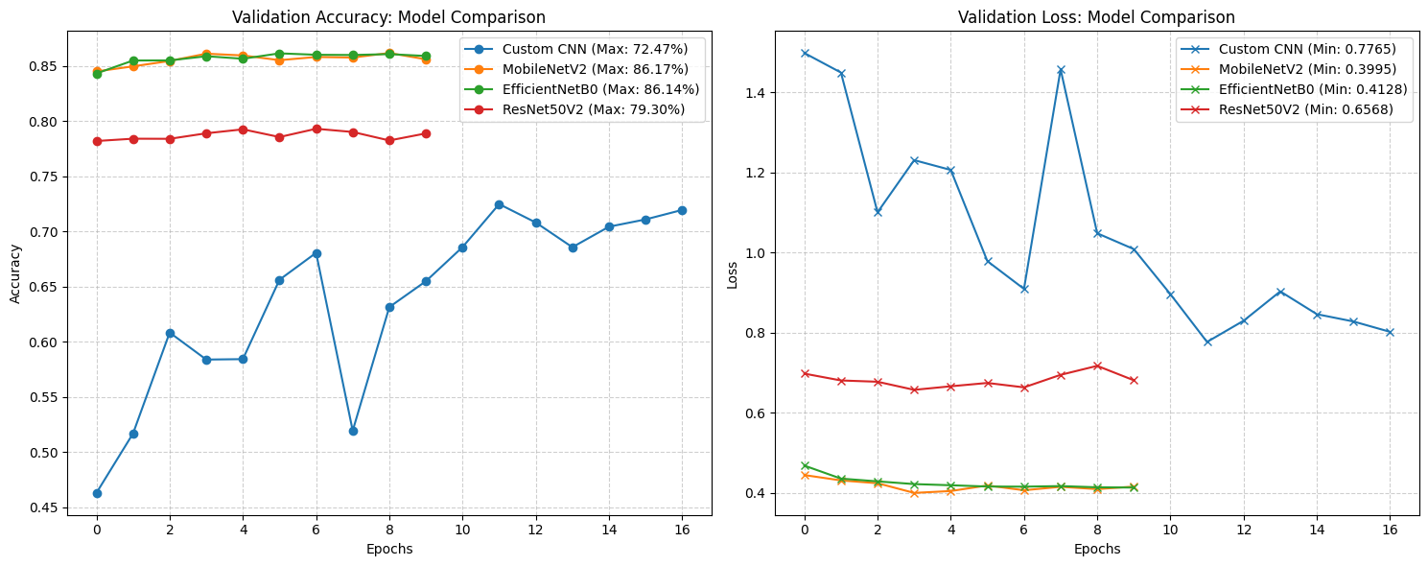
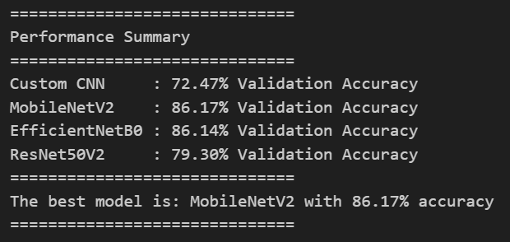
5. Comparison Plots & Best Model

Slide 9
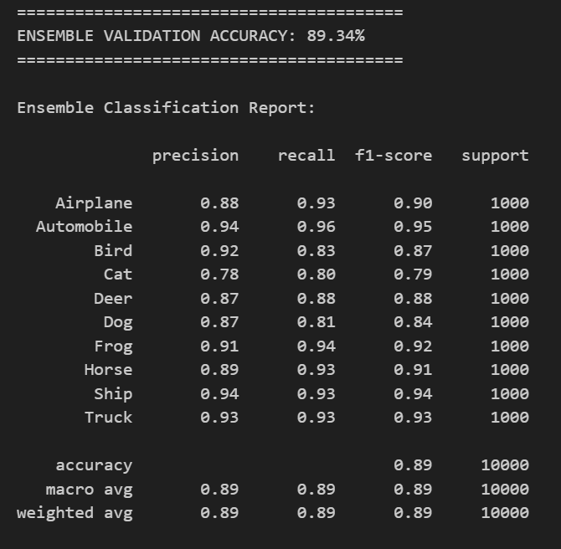
6. Ensemble
Ensemble in a soft voting system the two best models (MobileNetV2 & EfficientNetB0)
Soft Voting:
ensemble_avg_probs = np.mean(all_probabilities, axis=0)
Final class prediction:
ensemble_final_classes = np.argmax(ensemble_avg_probs, axis=1)
For loop enumerating the models_list:
probs=model.predict(
X_test, verbose=0) all_probabilities.append(probs)

